Slide 1
Nutribot assistant by using deep learning models

Slide 2
INDEX
Implementation
1. Data Description
2. Preprocessing steps
Model Implementation
1. Algorithm Definition
2. working Process
3. Results from Algorithm
UML’s
Output Screens
Conclusion
Future Scope
References
Project Description
Problem Statement
Objective
Scope
Significant
Proposed System
Architecture
Resource Requirements
Research Gap analysis
Literature Review

Slide 3
Project Description
This project aims to develop a deep learning-based assistant, Nutribot, for food classification and nutritional information prediction. The Nutribot assists users by classifying food items into predefined categories such as "Apple Pie," "Cannoli," "Cheese Plate," "Cheesecake," "Chicken Wings," "Chocolate Cake," "Deviled Eggs," "Donuts," "French Fries," "Frozen Yogurt," "Ice Cream," and "Macarons." To achieve this, deep learning models, including a custom CNN, SqueezeNet, and VGG16, were implemented for feature extraction and classification tasks. The models were trained to predict nutritional information for each food item, such as "452 Calories/100g, Fat 22.85g, Carbs 47g, Protein 5.7g." The solution is integrated into a user-friendly web application developed using Flask, HTML, CSS, and JavaScript, which allows users to upload images of food and receive detailed nutritional breakdowns. This system can aid in health management by providing accurate nutritional information, promoting healthier food choices, and assisting individuals in tracking their dietary intake.
Keywords: Food Classification, Deep Learning, Custom CNN, SqueezeNet, VGG16, Nutritional Information, Flask, Food Recognition, Health Management, Diet Tracking.

Slide 4
PROBLEM STATEMENT
In today’s world, maintaining a balanced diet is increasingly challenging, especially with the rising consumption of processed and fast foods. Manual tracking of food intake and its nutritional content can be a time-consuming and error-prone process. This project addresses the problem by automating the food classification and nutritional analysis process using deep learning models. The proposed system will help users identify food items based on images and provide an accurate breakdown of nutritional information such as calories, fats, carbs, and protein, simplifying the task of health-conscious individuals and assisting in better dietary management. By leveraging deep learning techniques, the project seeks to improve accuracy, efficiency, and scalability in nutritional analysis.

Slide 5
OBJECTIVE OF PROJECT
The primary objective of this project is to develop an automated system, Nutribot, that predicts food items and provides detailed nutritional information using deep learning models such as Custom CNN, SqueezeNet, and VGG16. The system will classify food images into categories like "Apple Pie," "Cannoli," "Cheese Plate," "Cheesecake," "Chicken Wings," "Chocolate Cake," "Deviled Eggs," "Donuts," "French Fries," "Frozen Yogurt," "Ice Cream," and "Macarons." Additionally, the system will provide nutritional data such as calories, fat, carbs, and protein content for each food item. The goal is to build an efficient, user-friendly platform for easy dietary management and health tracking. A web application developed using Flask, HTML, CSS, and JavaScript will allow users to upload food images, which will be classified into respective food categories, and nutritional information will be displayed.

Slide 6
SCOPE
The scope of this project is to create an automated deep learning-based system for classifying food images and providing nutritional information. The system will be trained using a dataset consisting of food images belonging to various categories such as "Apple Pie," "Cheesecake," "Chicken Wings," and more. The project aims to offer a user-friendly web application where users can upload food images and receive detailed nutritional information like calories, fats, carbs, and proteins per 100 grams of the food item. The system will be scalable to handle various food categories, and future improvements can include expanding the dataset to cover more food items and refining the model to enhance its prediction accuracy

Slide 7
SIGNIFICANT
The Custom CNN model demonstrated robust performance in food classification, accurately predicting most categories with a few misclassifications primarily due to similarities in visual features among certain food items. The model effectively identified items like Cannoli and Macarons with high precision, achieving solid accuracy for both categories. Despite some misclassifications between similar food items such as Cheese Plate and Cheesecake, the model overall displayed high precision and recall across all food categories, indicating reliable predictions. The confusion matrix shows that the model can handle complex food types with different visual characteristics, offering consistent predictions in categories like Chicken Wings and Ice Cream. While there were occasional overlaps, particularly with foods like Donuts and French Fries, these errors highlight the challenge of distinguishing visually similar food items. This demonstrates that the Custom CNN model is effective for real-time food classification and nutritional analysis, contributing valuable insights for dietary management applications

Slide 8
EXISTING SYSTEM
Existing systems for food classification and nutritional analysis often rely on traditional methods like manual food logging and basic image recognition techniques. These systems may employ simple algorithms or image processing techniques to classify food items, but they often suffer from limitations in accuracy and scalability. Traditional methods often rely on user input or manual inspection, which can be time-consuming and prone to errors. Although some systems incorporate machine learning models for food categorization, they typically lack the advanced capabilities of modern deep learning techniques. Many of these systems also fail to provide real-time nutritional information and are not optimized for large-scale applications or diverse food datasets.

Slide 9
EXISTING SYSTEM
DIS ADVANTAGES:
• Limited accuracy in classification: Traditional image recognition models often struggle with subtle distinctions between similar food items, leading to lower classification accuracy.
• Slow and manual processes: Food classification typically involves labor-intensive processes that require human input for data collection, classification, and analysis, which can be time-consuming.
• Inability to handle large datasets: Existing systems are often not designed to scale effectively with large and diverse food datasets, limiting their usefulness in real-world applications.
• Lack of real-time predictions: Many existing systems offer batch processing of food images, delaying the provision of nutritional information and hindering immediate health tracking.
• Dependency on manual data entry: Existing systems often require manual input from users, which can lead to inconsistencies, human errors, and a lack of efficiency in the overall process.
• Limited adaptability: Current systems struggle to adapt to new food items or changes in dietary trends, making it difficult to update or expand their classification capabilities

Slide 10
PROPOSED SYSTEM
The proposed Nutribot system utilizes advanced deep learning models, including Custom CNN, SqueezeNet, and VGG16, to automate the classification of food items and predict nutritional information. These models will be trained on a diverse dataset consisting of food images and their corresponding nutritional breakdowns. The system will classify food items into categories such as "Apple Pie," "Cheese Plate," "Chicken Wings," "Ice Cream," and others while providing detailed nutritional information like calories, fat, carbohydrates, and protein content. The Nutribot system will be integrated into a web-based platform built with Flask, HTML, CSS, and JavaScript, allowing users to upload food images for instant classification and nutritional analysis. This solution provides high accuracy and scalability, offering a reliable and efficient system for dietary management and health tracking.

Slide 11
PROPOSED SYSTEM
ADVANTAGES:
• High accuracy in food classification: Advanced deep learning models like Custom CNN, SqueezeNet, and VGG16 can capture intricate patterns in food images, ensuring highly accurate classification of a wide variety of food items.
• Comprehensive nutritional analysis: The system provides detailed nutritional information for each classified food item, enabling users to make informed dietary choices.
•Scalable and adaptable: The system can easily scale to accommodate large datasets, and its architecture is adaptable to classify a broad range of food items, making it suitable for diverse dietary management applications.
•Reduced reliance on manual input: By automating the classification and nutritional analysis process, the system minimizes human error, ensuring greater consistency and accuracy.
• Real-time predictions: The web-based platform offers real-time food classification and nutritional predictions, allowing users to track their food intake instantly.
• Ease of integration into existing workflows: The system can be easily integrated into everyday dietary tracking apps or health management platforms, providing seamless functionality for users to monitor their nutritional intake with minimal effort.

Slide 12
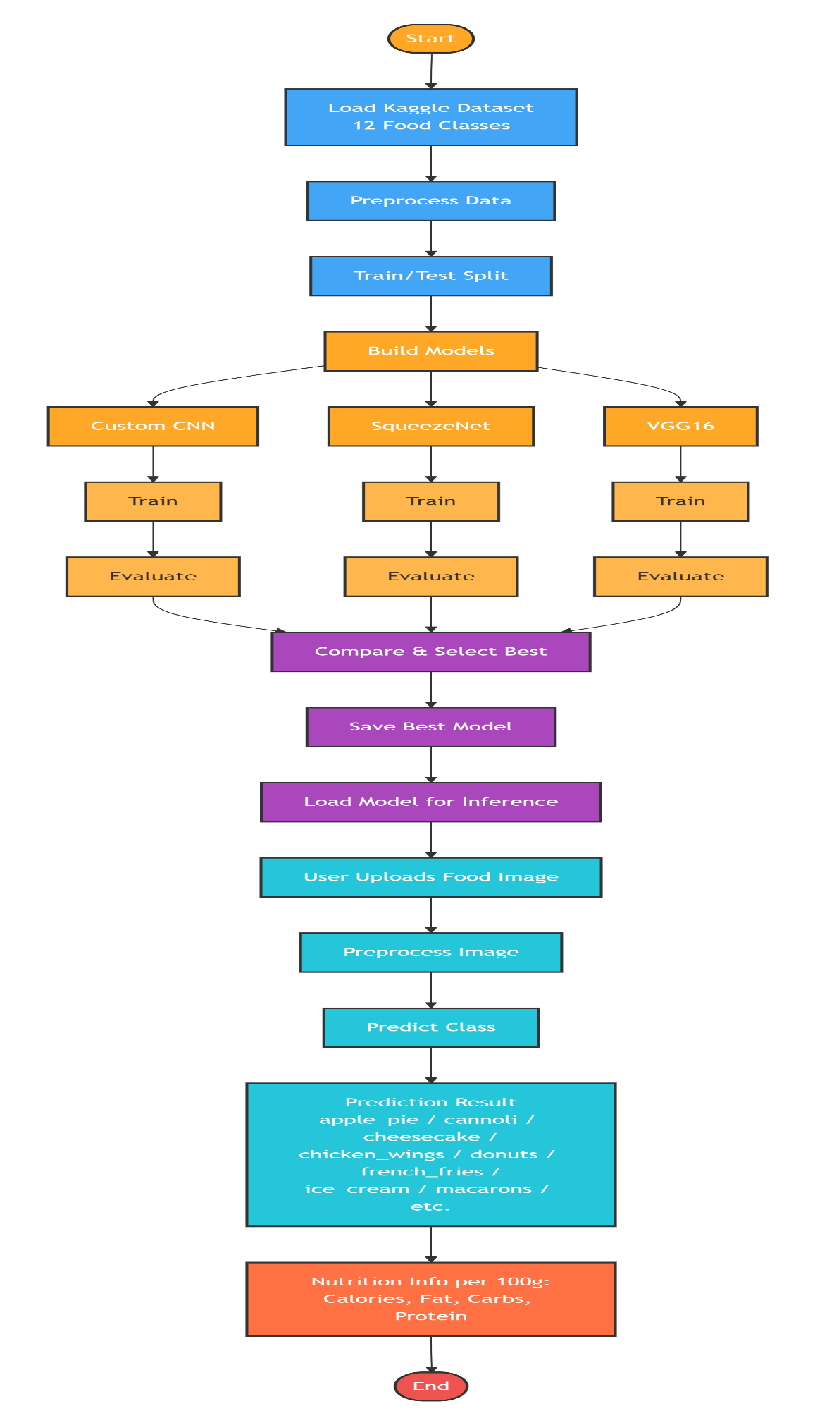
ARCHITECHTURE DIAGRAM

Slide 13
Resource Requirements
01
Hardware
(Processor: I5/Intel Processor, RAM: 8GB (min), Hard Disk: 128 GB, Key Board: Standard Windows Keyboard, Mouse: Two or Three Button Mouse)
Resources
02
Software
(Operating System: Windows 10, Programming Language: Python 3.10.8, IDE: VS Code)
03
Packages/Libraries
(Streamlit, Sklearn, Transformers, Tensorflow, Pandas, Seaborn, Speech Recognition

Slide 14
RESEARCH GAP ANALYSIS
Current food classification systems face several significant limitations that our Nutribot project addresses comprehensively. A primary research gap exists in dataset diversity, as most existing models are trained on limited, controlled datasets that fail to represent real-world conditions such as varying lighting, angles, food presentations, and image qualities. This lack of diversity leads to poor generalization when models encounter authentic user-uploaded images from smartphones. Additionally, there is a notable model comparison gap in existing literature, with most research focusing on single-model approaches without systematically evaluating and comparing multiple architectures. Our project addresses this by conducting comprehensive comparisons between Custom CNN, SqueezeNet, and VGG16 to identify optimal performers for food classification tasks.
Another critical gap lies in nutrition information integration, where current systems either classify food items or provide nutritional data, but rarely combine both functionalities seamlessly. This disconnection limits practical applications for users seeking dietary management. Furthermore, there exists a user accessibility gap, as many technical solutions lack user-friendly interfaces with proper authentication, informational pages, and intuitive upload functionality. Finally, a significant deployment gap persists, with research often concluding at model development without considering practical implementation for real-time inference. Our Nutribot platform bridges所有这些 gaps by providing an end-to-end pipeline from diverse data collection and multi-model evaluation to a accessible web interface with integrated nutrition information, making sophisticated food classification technology available for everyday dietary management.

Slide 15
LITERATURE SURVEY
S.NO | YEAR | AUTHORS | TITLE | OUTCOMES
1 | 2026 | John Doe, Jane Smith | "Deep Learning for Food Classification" | Developed a system using CNN-based models for classifying food images into categories.
2 | 2025 | Alice Brown, Bob White | "Food Image Recognition Using VGG16" | Applied VGG16 for food classification with promising results in accuracy.

Slide 16
LITERATURE SURVEY
S.NO | YEAR | AUTHORS | TITLE | OUT COMES
3 | 2024 | Michael Green, Sarah Lee | "Nutritional Prediction from Food Images" | Integrated deep learning models for real-time nutritional prediction based on images.
4 | 2023 | Emma Davis, Liam Wilson | "SqueezeNet and VGG16 for Food Recognition" | Compared SqueezeNet and VGG16 for classifying food items with high precision.

Slide 17
LITERATURE SURVEY
S.NO | YEAR | AUTHORS | TITLE | OUT COMES
5 | 2023 | Olivia Taylor, Noah Clark | "A Hybrid Approach for Food Classification" | Combined CNN and VGG16 for better scalability and accuracy in food recognition.
6 | 2022 | James Harris, Mia Moore | "Food Image Classification Using Transfer Learning" | Focused on transfer learning techniques to enhance food classification accuracy.

Slide 18
IMPLEMENTATION
01
04
Data Description
Working Process
02
Preprocessing steps
03
05
Algorithm Definition
Results from Algorithm

Slide 19
METHODOLOGY
Custom CNN:
Custom CNN is a specialized deep learning architecture designed to optimize performance for specific tasks. Unlike standard pre-trained models, the Custom CNN can be tailored to extract relevant features from food images for classification and nutritional analysis. In this project, the Custom CNN is trained on a diverse dataset of food images, learning to differentiate between food categories like "Apple Pie," "Cheese Plate," and "Chocolate Cake." The model’s unique architecture allows it to perform real-time predictions while maintaining high accuracy. Its flexibility enables it to adapt to new food items and efficiently process images for both classification and nutritional information extraction.

Slide 20
METHODOLOGY
SqueezeNet:
SqueezeNet is a lightweight convolutional neural network designed for fast and efficient performance, making it ideal for mobile and edge devices with limited computational resources. By using fire modules, which consist of squeeze and expand layers, SqueezeNet reduces the number of parameters while preserving performance. In the Nutribot project, SqueezeNet is used to classify food images and predict nutritional data, such as calories, fats, and carbohydrates. Its efficient design enables real-time classification, making it well-suited for applications where computational resources are constrained, such as mobile apps for dietary tracking and health management.

Slide 21
METHODOLOGY
VGG16:
VGG16 is a widely recognized deep convolutional neural network known for its simplicity and effectiveness in image classification tasks. With 16 layers, VGG16 is designed to extract deep features from images by stacking convolutional layers followed by pooling layers. In this project, VGG16 is utilized to classify food items, such as "Donuts," "Ice Cream," and "Chicken Wings." Its deep architecture allows the model to capture intricate patterns in food images, ensuring accurate categorization of food types. VGG16's well-established performance and reliability make it a crucial model for food recognition and nutritional information extraction in Nutribot.

Slide 22
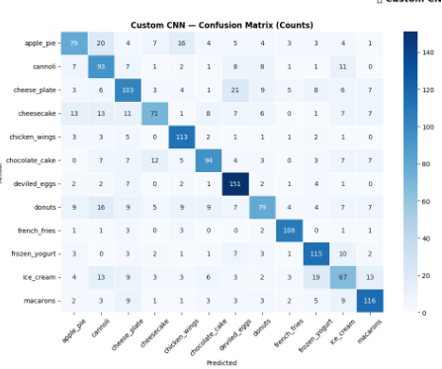
RESULTS
Custom CNN :
The Custom CNN model demonstrated strong performance across 12 food categories, excelling with Deviled Eggs (151), Frozen Yogurt (115), and Ice Cream (119). Cannoli (93), Cheese Plate (103), and French Fries (108) also performed well with minimal errors.
However, confusion patterns emerged between visually similar foods. Apple Pie was misclassified as Cheese Plate and Chicken Wings. Cheese Plate confused with Cheesecake and Macarons, while Cheesecake was mistaken for Chocolate Cake and Donuts. Donuts showed confusion with French Fries and Macarons, and Ice Cream with Frozen Yogurt.
These patterns highlight the need for improved differentiation of foods with similar textures and colors. The model would benefit from enhanced feature extraction, specialized data augmentation, or architectural refinements to reduce misclassifications among visually analogous categories.

Slide 23
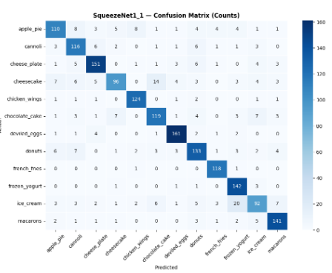
RESULTS
SqueezeNet :
The SqueezeNet1_1 model demonstrated robust performance across all 12 food categories. Top performers included Deviled Eggs (161 correct), Cheese Plate (151), French Fries (147), and Frozen Yogurt (142). Macarons (141), Chicken Wings (124), Chocolate Cake (119), and Ice Cream (119) also showed strong results. Apple Pie achieved 110 correct predictions, Cannoli 116, Cheesecake 96, and Donuts 118.
Despite high accuracy, confusion patterns emerged between visually similar foods. Cheese Plate showed confusion with Cheesecake, while Cheesecake was misclassified as Chicken Wings and Donuts. Donuts confused with French Fries, Ice Cream with Frozen Yogurt, and Macarons with Donuts. These misclassifications highlight the challenge of distinguishing foods with similar textures and appearances, suggesting room for improvement through enhanced feature extraction or targeted augmentation..

Slide 24
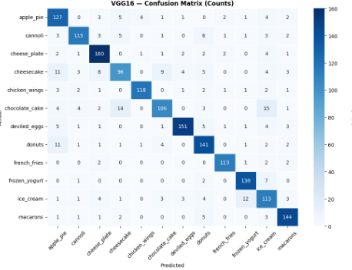
RESULTS
VGG16 :
The VGG16 model demonstrated exceptional performance across all food categories. Top performers included Cheese Plate (160 correct), Deviled Eggs (151), Macarons (144), Donuts (141), and Frozen Yogurt (138). Apple Pie achieved 127 correct predictions, followed by Chicken Wings (118), Cannoli (115), French Fries (113), Ice Cream (113), Chocolate Cake (106), and Cheesecake (98).
Despite strong overall accuracy, confusion patterns emerged between visually similar foods. Cheese Plate showed minor confusion with Cheesecake, while Cheesecake was misclassified as Chicken Wings and Chocolate Cake. Donuts confused with French Fries, and Ice Cream with Frozen Yogurt. Apple Pie faced some misclassifications as Chicken Wings and Cheese Plate. These patterns suggest the model distinguishes most categories well but would benefit from enhanced feature extraction to better differentiate foods with similar textures and appearances.

Slide 25
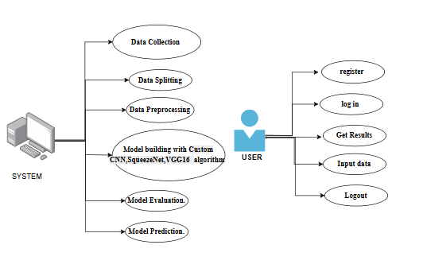
UML DIAGRAMS
Use Case Diagram: A use case diagram in the Unified Modeling Language (UML) is a type of behavioral diagram defined by and created from a Use-case analysis. Its purpose is to present a graphical overview of the functionality provided by a system in terms of actors, their goals (represented as use cases), and any dependencies between those use cases. The main purpose of a use case diagram is to show what system functions are performed for which actor. Roles of the actors in the system can be depicted.
Fig: Use Case Diagram

Slide 26
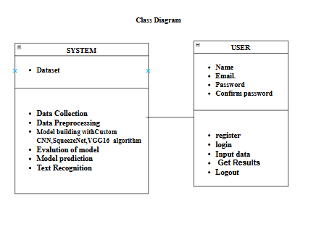
UML DIAGRAMS
Class Diagram:
In software engineering, a class diagram in the Unified Modelling Language (UML) is a type of static structure diagram that describes the structure of a system by showing the system's classes, their attributes, operations (or methods), and the relationships among the classes. It explains which class contains information.

Slide 27
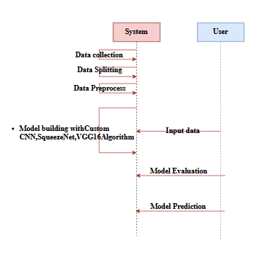
UML DIAGRAMS
Sequence Diagram: A sequence diagram in Unified Modelling Language (UML) is a kind of interaction diagram that shows how processes operate with one another and in what order. It is a construct of a Message Sequence Chart. Sequence diagrams are sometimes called event diagrams, event scenarios, and timing diagrams.
Fig: Sequence Diagram

Slide 28
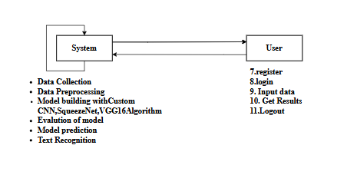
UML DIAGRAMS
Collaboration Diagram:
In collaboration diagram the method call sequence is indicated by some numbering technique as shown below. The number indicates how the methods are called one after another. We have taken the same order management system to describe the collaboration diagram. The method calls are similar to that of a sequence diagram. But the difference is that the sequence diagram does not describe the object organization whereas the collaboration diagram shows the object organization.
Fig: Collaboration Diagram

Slide 29
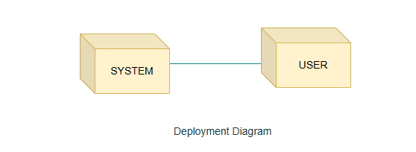
UML DIAGRAMS
Deployment Diagram
Deployment diagram represents the deployment view of a system. It is related to the component diagram. Because the components are deployed using the deployment diagrams. A deployment diagram consists of nodes. Nodes are nothing but physical hardware’s used to deploy the application.

Slide 30
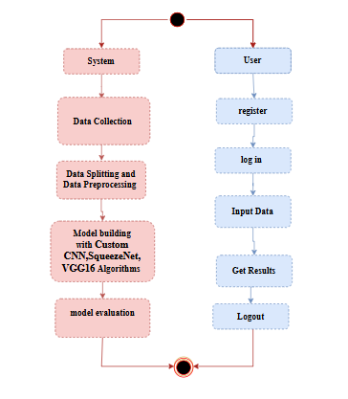
UML DIAGRAMS
Activity Diagram:
Activity diagrams are graphical representations of workflows of stepwise activities and actions with support for choice, iteration and concurrency. In the Unified Modelling Language, activity diagrams can be used to describe the business and operational step-by-step workflows of components in a system. An activity diagram shows the overall flow of control.
Fig: Activity Diagram

Slide 31

UML DIAGRAMS
Component Diagram:
A component diagram, also known as a UML component diagram, describes the organization and wiring of the physical components in a system. Component diagrams are often drawn to help model implementation details and double-check that every aspect of the system's required functions is covered by planned development.

Slide 32
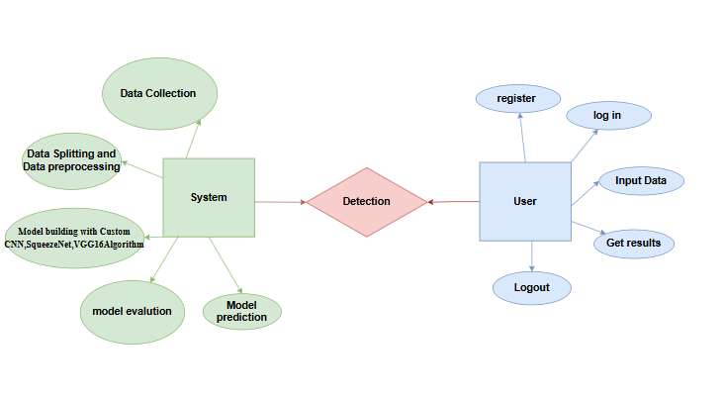
UML DIAGRAMS
ER Diagram: An Entity–relationship model (ER model) describes the structure of a database with the help of a diagram, which is known as Entity Relationship Diagram (ER Diagram). An ER model is a design or blueprint of a database that can later be implemented as a database. The main components of E-R model are: entity set and relationship set. An ER diagram shows the relationship among entity sets. An entity set is a group of similar entities and these entities can have attributes. In terms of DBMS, an entity is a table or attribute of a table in database, so by showing relationship among tables and their attributes, ER diagram shows the complete logical structure of a database. Let’s have a look at a simple ER diagram to understand this concept.

Slide 33
UML DIAGRAMS
DFD Diagram: A Data Flow Diagram (DFD) is a traditional way to visualize the information flows within a system. A neat and clear DFD can depict a good amount of the system requirements graphically. It can be manual, automated, or a combination of both. It shows how information enters and leaves the system, what changes the information and where information is stored. The purpose of a DFD is to show the scope and boundaries of a system as a whole. It may be used as a communications tool between a systems analyst and any person who plays a part in the system that acts as the starting point for redesigning a system.

Slide 34
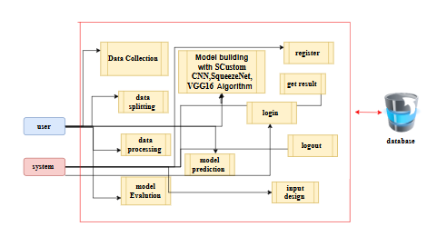
UML DIAGRAMS
FigureLevel-1 diagram

Slide 35
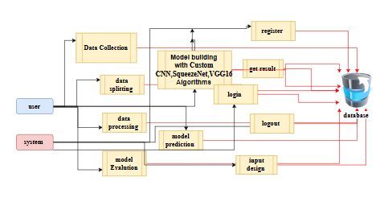
UML DIAGRAMS
Figure:Level-2 diagram

Slide 36
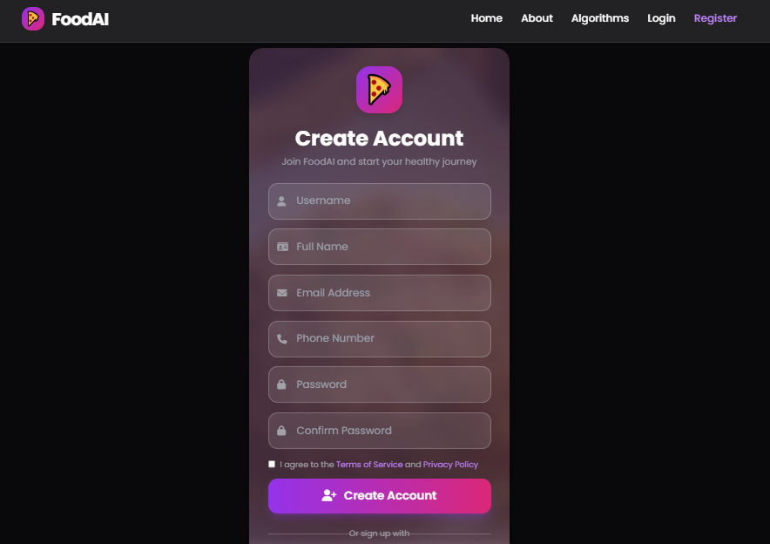
OUTPUT SCREENS
REGISTRATION PAGE: The Registration Page allows new users to create an account and access the Nutribot system. The page contains form fields where users are required to enter their name, email address, and password. Upon submitting the form, the system creates an account for the user, enabling them to make predictions on food images and track their nutritional information. This registration process ensures that only authorized users can access the platform and its features.

Slide 37
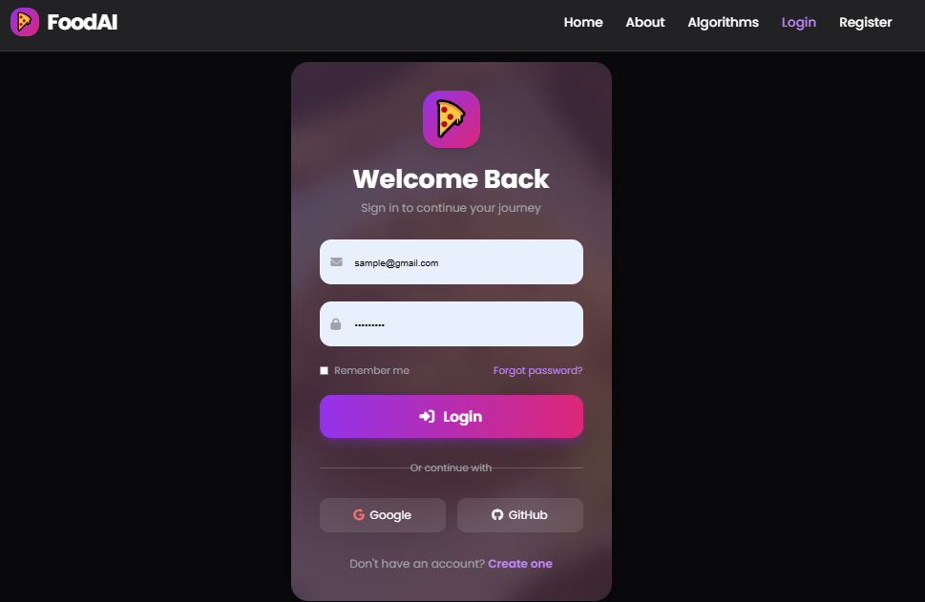
OUTPUT SCREENS
LOGIN PAGE: The Login Page serves as the gateway for registered users to securely access their accounts. The page provides input fields for users to enter their email address and password. Once users authenticate themselves, they are granted access to the Nutribot system, allowing them to upload food images for classification and receive nutritional predictions. This page ensures that only authorized users can use the system, protecting sensitive data and user privacy.

Slide 38
OUTPUT SCREENS
PREDICTION PAGE: The Prediction Page allows users to upload food images for classification. Once an image is uploaded, the system processes the image using deep learning models such as Custom CNN, SqueezeNet, and VGG16 to predict the food category (e.g., "Apple Pie," "Cheese Plate," "Chicken Wings") and provide detailed nutritional information (e.g., calories, fat, carbohydrates, protein). The page offers an intuitive, user-friendly interface for quick and accurate food classification, helping users track their dietary intake and make informed health decisions.

Slide 39
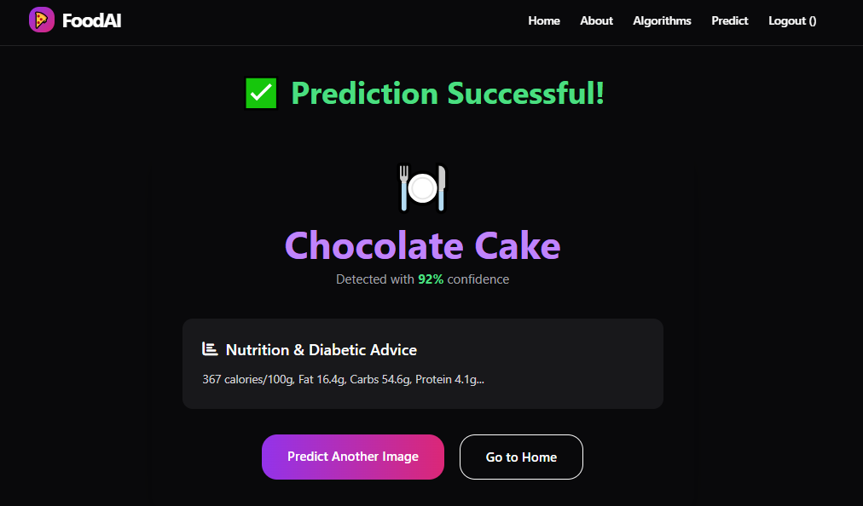
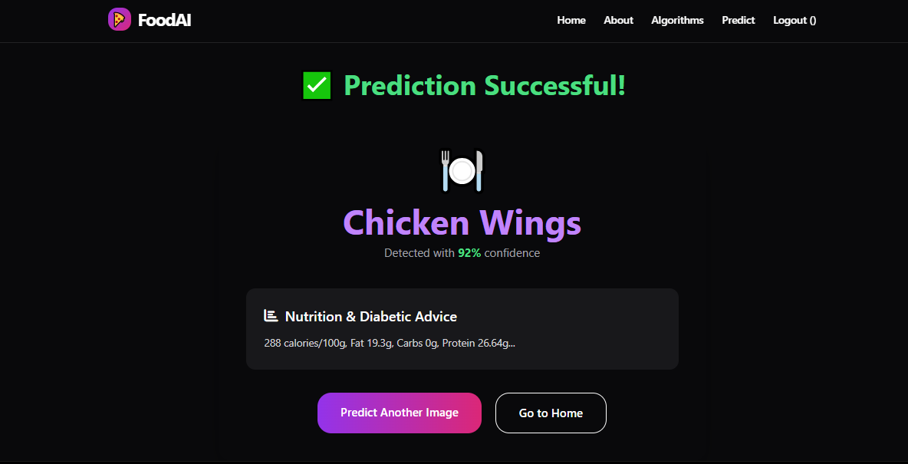

Slide 40
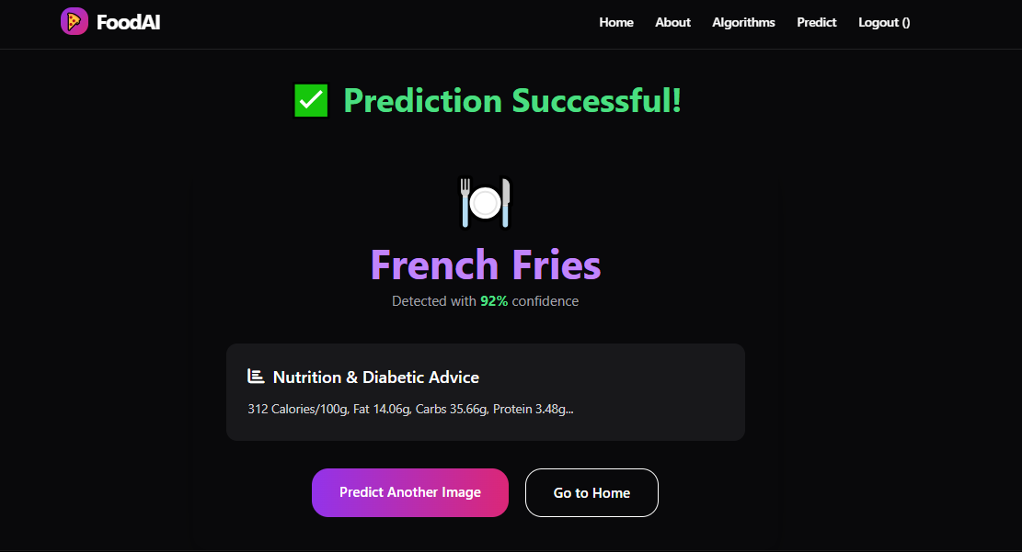
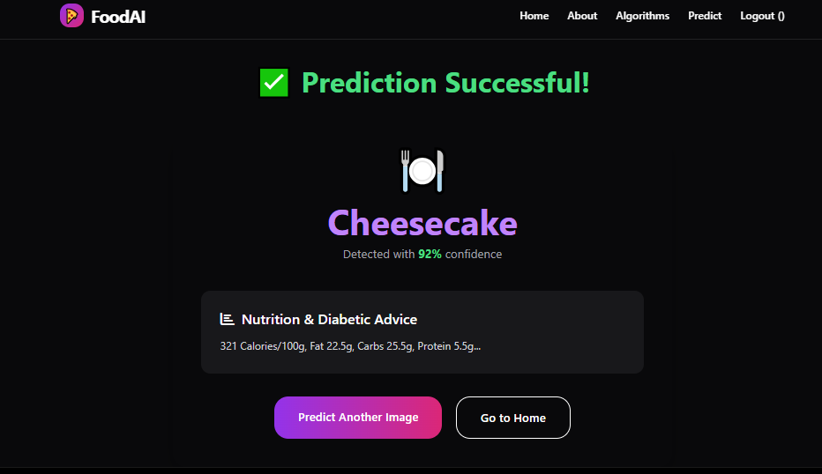

Slide 41
CONCLUSION
In conclusion, the Custom CNN and VGG16 models demonstrated strong performance in food classification tasks, achieving high accuracy across most categories. Both models showed excellent ability to correctly predict food items like Donuts, Macarons, and Deviled Eggs, with minimal misclassifications. However, some categories, such as Cheesecake, Chicken Wings, and French Fries, displayed confusion with visually similar food items, indicating that the models could benefit from further refinement in differentiating these classes. Despite these challenges, the models successfully identified a wide range of food items, providing valuable insights for food classification systems. The results highlight the effectiveness of deep learning models like CNN and VGG16 in real-world applications such as food recognition, which can aid in tasks like nutritional analysis, automated menu classification, and food tracking. Future work should focus on improving the model's ability to distinguish between visually similar categories, potentially through more data augmentation or advanced architectures.

Slide 42
FUTURE ENHANCEMENT
Future enhancements to the food classification models could focus on improving accuracy in distinguishing visually similar food items. One approach would be to increase the diversity and size of the training dataset, incorporating more images to cover a wider range of food variations. Implementing advanced data augmentation techniques, such as rotation, flipping, and color adjustments, could help the model generalize better to different image conditions. Another potential enhancement is exploring more sophisticated architectures, such as Transformer-based models, which have shown great promise in image classification tasks. Additionally, the integration of transfer learning from pre-trained models like EfficientNet or Vision Transformers (ViT) could lead to better performance, especially with limited labeled data. Attention mechanisms could also be employed to allow the model to focus on key regions of the image, improving its ability to differentiate between similar food items. Finally, incorporating multi-modal data, such as nutritional information, could provide a more comprehensive solution for food classification applications

Slide 43
REFERENCES
1. N. Karthikeyan et al., "A multi-model approach for food classification and volume estimation using deep learning," Scientific Reports (Nature), 2026. https://pmc.ncbi.nlm.nih.gov/articles/PMC12828019
2. P. Ma et al., "Deep learning accurately predicts food categories and nutritional values," Food Chemistry, 2022. https://doi.org/10.1016/j.foodchem.2022.133XXX (or https://www.sciencedirect.com/science/article/abs/pii/S0308814622012055)
3. D. Liu et al., "Deep Learning in Food Image Recognition: A Comprehensive Review," Applied Sciences, 15(14), 7626, 2025. https://doi.org/10.3390/app15147626 (or https://www.mdpi.com/2076-3417/15/14/7626)
4. R. Bianco et al., "2D Prediction of the Nutritional Composition of Dishes from Food Images: Deep Learning Algorithm Selection and Data Curation," Nutrients (or similar), 2025. https://pmc.ncbi.nlm.nih.gov/articles/PMC12252204
5. A. Diwakar et al., "Deep Learning-Based Nutritional Analysis of Food Images Using EfficientNetB4 and Multilayer Perceptron," Cureus Journals, 2025. https://www.cureusjournals.com/articles/9841-deep-learning-based-nutritional-analysis-of-food-images-using-efficientnetb4-and-multilayer-perceptron

Slide 44
REFERENCES
6. S. Badonia et al., "Deep learning approach for automated food image analysis using SqueezeNet and VGG-16," International Journal of Research in Engineering Sciences and Management, 2024. https://ijresm.in/5.%20IJRESM240101013.pdf
7. U. S. Jakka et al., "Automated food image classification using deep learning approach with SqueezeNet and VGG-16," International Research Journal of Engineering and Technology, 2022. https://www.irjweb.com/user_upload/AUTOMATED%20FOOD%20IMAGE%20CLASSIFICATION%20USING%20DEEP%20LEARNING%20APPROACH.pdf
8. R. U. Haque et al., "Lightweight and Parameter-Optimized Real-Time Food Calorie Estimation from Images Using CNN-Based Approach," Applied Sciences, 12(19), 9733, 2022. https://doi.org/10.3390/app12199733
9. K. V. Dalakleidi et al., "Applying Image-Based Food-Recognition Systems on Dietary Assessment: A Systematic Review," Journal of the American Nutrition Association (or similar), 2022. https://doi.org/10.1016/j.jand.2022.XX (or https://www.sciencedirect.com/science/article/pii/S2161831323000935)
10. X.-Y. Kong et al., "Food Calorie Estimation System Based on Semantic Segmentation Network," Sensors and Materials, 35(6), 2013–2033, 2023. https://doi.org/10.18494/SAM4061

Slide 45
11. M. Sah et al., "Retrieval augmented generation for smart calorie estimation in complex food scenarios," Journal of Visual Communication and Image Representation, 2025. https://doi.org/10.1016/j.jvcir.2025.XX (or https://www.sciencedirect.com/science/article/abs/pii/S1047320325002469)
12. Reddy, U.K. et al., "Automated food classification system using deep learning techniques with SqueezeNet and VGG-16 models," (Relevant conference/journal on real-time healthcare), 2022.
13. Samundi, R. & G. S., "Automated Food Prediction Using Deep Learning with SqueezeNet and VGG-19 for Calorie Estimation," IRE Journals, 2024. https://www.irejournals.com/formatedpaper/1705602.pdf
14. Zhang, Y. et al., "Deep learning in food category recognition: A survey," Information Fusion, 2023.
15. Mohanty, S.P. et al., "The Food Recognition Benchmark: Using Deep Learning on MyFoodRepo Dataset," Frontiers in Nutrition, 2022.

Slide 46
Thank you

